Slide 1
Introduction to Go and C Programming Languages

Slide 2



C:
Developed in 1972
Low-level language
Used in systems programming(OS, Embedded Systems)
Go:
Created by Google in 2009
Efficient High-level language
Popular for cloud apps, web servers and microservices
Notes:
Low-level: enable the programmer to carry out bit-wise operations

Slide 3
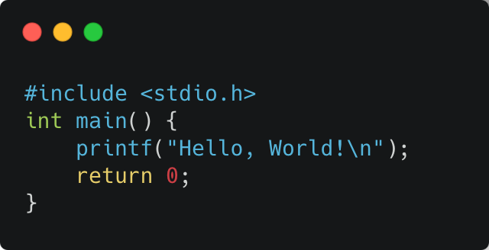
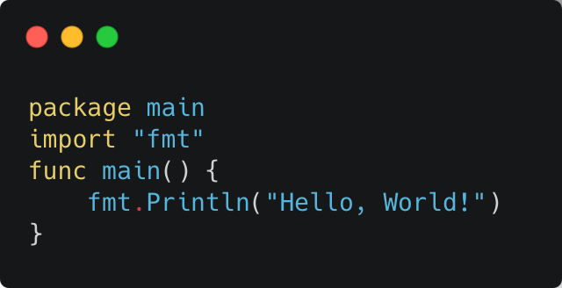
Syntax and Language Features
C:
Verbose syntax
Pointers
No built-in concurrency
Go:
Simpler, cleaner syntax
No pointer arithmetic
Native concurrency
Notes:
Concurrency : multiple computations are happening at the same time

Slide 4

Performance and Memory Management
C:
Closer to hardware
Manual memory management
Go:
Higher-level performance
Automatic memory managment

Slide 5

When to Use C vs. Go
C when:
You need hardware code
Performance & optimization
Sys programming or legacy apps
Go when:
Cloud-based systems, APIs, web apps with concurrency
Simple syntax & faster development
Working with microservices and need efficiency & scalability

